Slide 1
Topic: Measurement
EQ: How do I convert between volume and capacity units?
Year 11 Essentials
Notes:
Explaining this slide: Demonstrate the “type of response”: In 2 minutes (timed), you are going to share with your shoulder partner all of the formulas and examples you have written. You will get 2 mins (timed) to write down any formula/examples that your partners has that you haven’t and vice-versa. You and your partner then need to be prepared to share one formula and example on the board ( only choose 3 )
After marking the roll:
- Use active scanning and intervene if they are not. Use Private dialogue if needed

Slide 2
Learning Intentions
Students will be able to
calculate the volume and capacity of cubes, rectangular and triangular prisms and cylinders.

Slide 3
Things Required For This Lesson
Interactive Notebook
Textbook: Interleaved Maths Essential Connections
Ruler, Red Pen, Pencil, Pens, Scientific Calculator
Growth mindset

Slide 4

24
7
30
Topic: Measurement
EQ: Why is estimating and measuring accurately important?
WICOR
This Photo by Unknown Author is licensed under CC BY-SA

Slide 5
First 5
How many cm in 1.25km?
Find the Simple Interest owing on a loan of $7000 at 3.5% for 6 years.
What is the area of a rectangle with a length of 7m and width of 4m?
4. How many km² are 42000ha?
5.What is 6²x4+(16-4)-15?

Slide 6
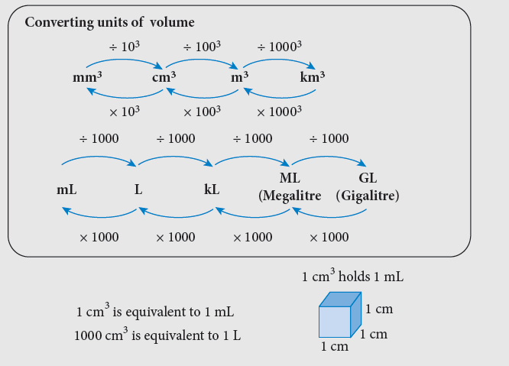
24
7
30
Measurement
Date
EQ – How do I convert between volume and capacity units?

Slide 7
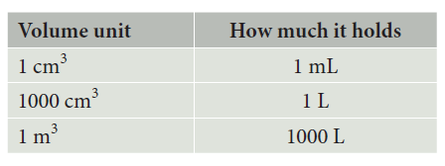
24
7
30
Measurement
Date
EQ – How do I convert between volume and capacity units?

Slide 8
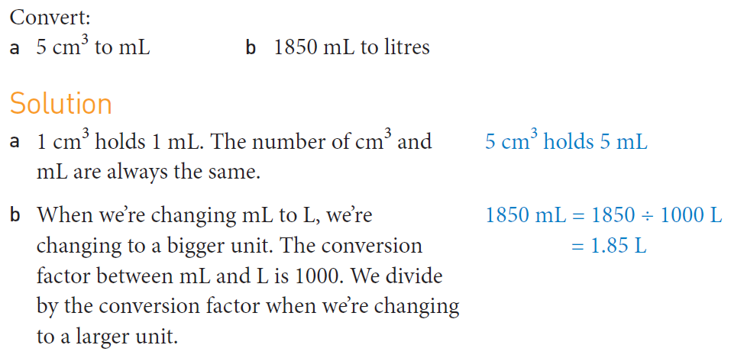
Practice

Slide 9
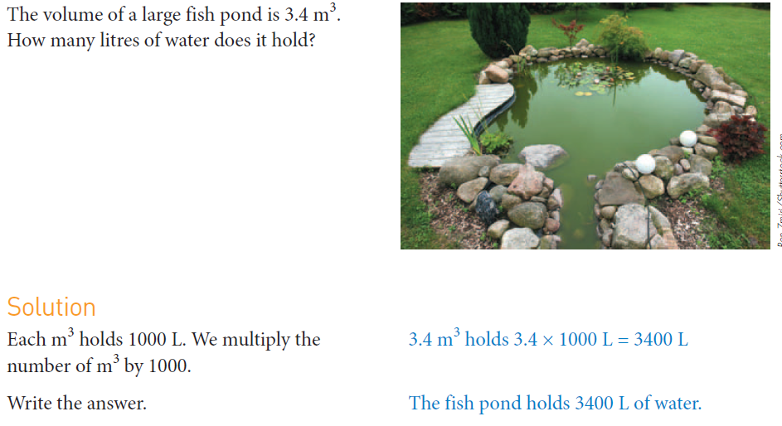

Slide 10
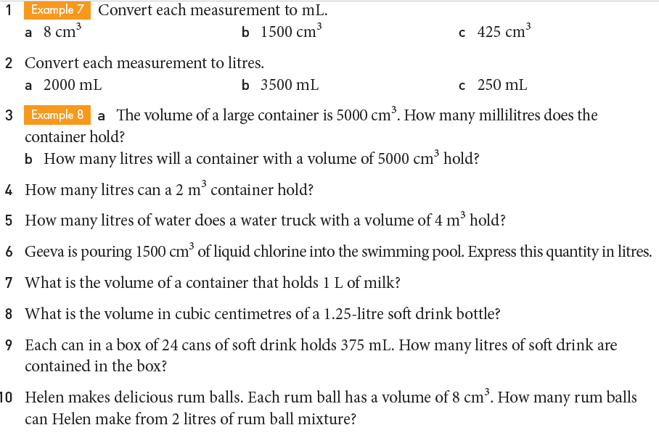
Task

Slide 11
